Slide 1



FOR JUST PLAY
Case Study – Data Analysis
Insights and Recommendations
Raj Pravin Rajendran
19/06/2024

Slide 2




ABOUT ME
Business Intelligence Analyst at Liberty Global
Portfolio
Raj Pravin Rajendran
Git Hub

Slide 3
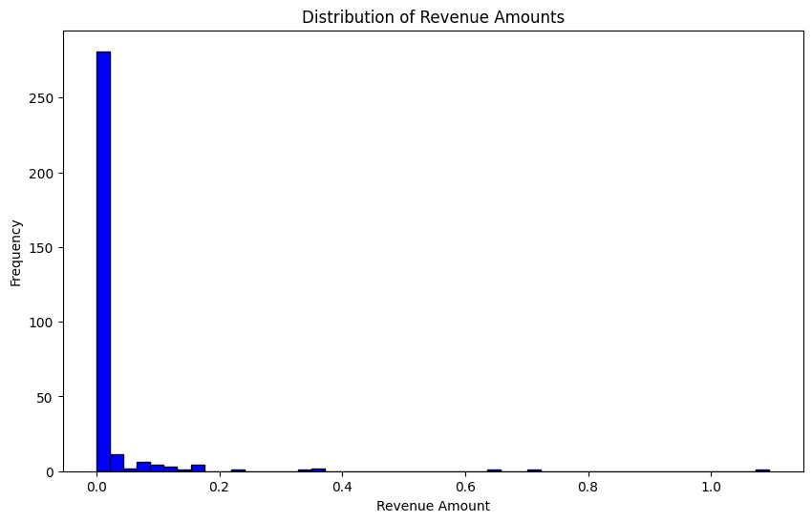
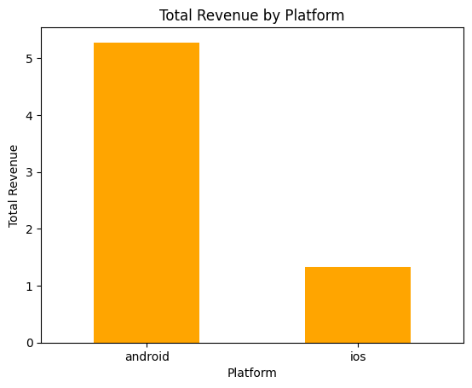
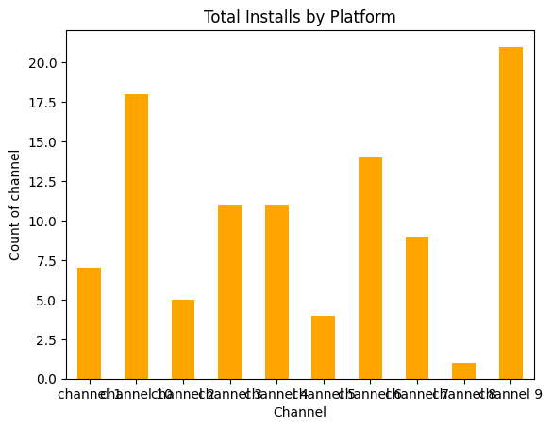
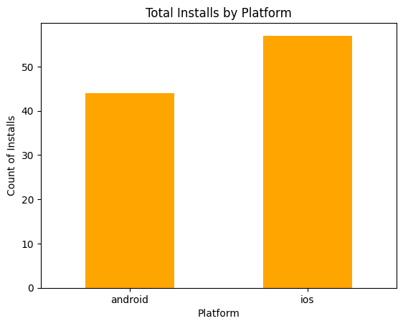
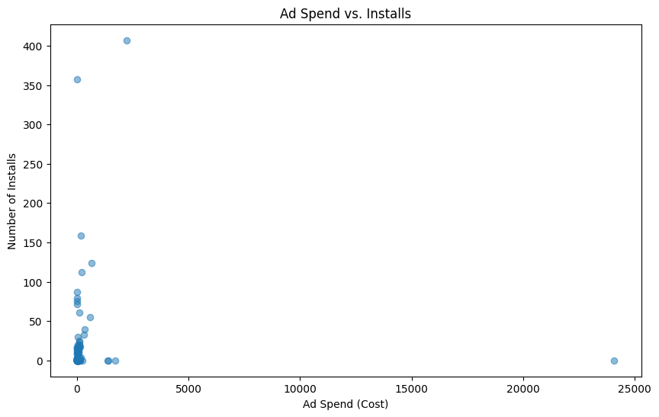
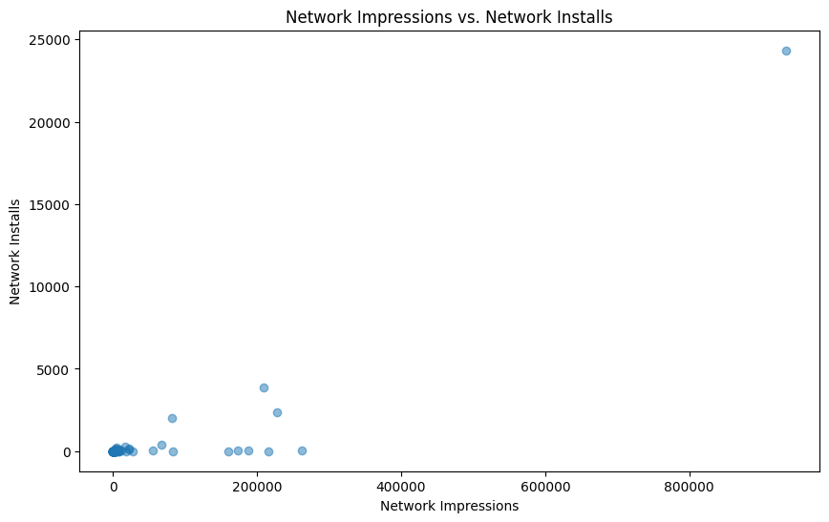
ExpExploratory Data Analysis
loratory Data Analysis
Definition
EDA
Graphs
Most revenue events occur on Android devices.
Distribution of revenue amounts is highly skewed, with many small transactions and a few large ones.
335 rows 13 columns
Contains details of revenue events such as user IDs, timestamps, country codes, platforms, revenue amounts, and ad network information.
01
Revenue
02
Majority of installs are from Android devices.
Various campaigns and channels are contributing to installs, with some channels performing better than others.
95 rows 13 Columns
Details on user installs, including user IDs, country codes, OS versions, device details, and associated ad campaign information.
Installs
Ad Spend
03
There is a significant variance in ad spend across different campaigns and channels.
Some campaigns have high impressions but low installs, indicating potential inefficiencies
39 rows 9 Columns
Information on ad spend, including clicks, impressions, installs, and costs by country and ad campaign.

Slide 4


Data Cleaning and Preparation:
Duplicates
Null Values
Revenue
Revenue
15 Duplicates
Country code – 6
Platform - 1
Installs
Installs
Google ad – 55
Idfa – 88
Idfv -42
Ad Spend
6 Duplicates
Ad Spend
0 Null Values
0 Duplicates
Impact of Null Values :
Null values can cause incomplete and misleading analysis.
Missing data can lead to inaccurate metrics and hinder the decision-making process.
Key insights might be missed due to gaps in the data.
Action Taken :
Revenue data:
Found and replaced the correct country code and platform name using the user ID from install data.
Deleted the row with the null value in the amount column as it would not impact the report.
Installs data:
Deleted the columns googleAdId, idfa, and idfa as they had a large number of null values and would not impact metrics or aggregation.
Impact of Duplicate Data :
Duplicate data causes incorrect aggregation values.
This can lead to inaccurate insights and poor decision-making.
Action Taken : Removed all duplicate values from the datasets.

Slide 5
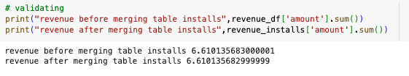
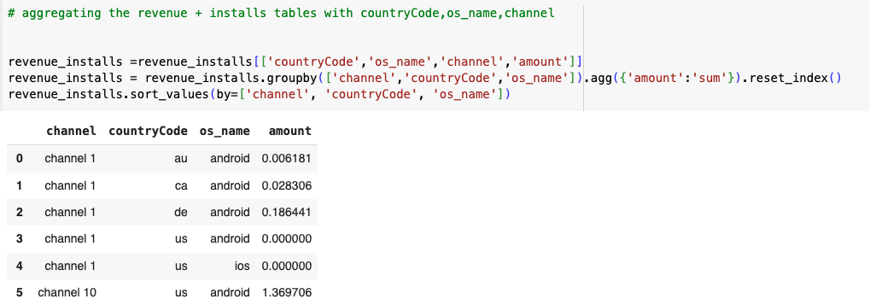
Aggregating and Merging Data:
Revenue Data Aggregation:
Aggregated the revenue data by user_id to ensure each user_id is unique with its corresponding total revenue and removed the column date since all the values in date column have same values.
Data Merging:
Performed a "left" join to merge the installs data with the aggregated revenue data using the user_id.
This ensures that all users who installed the application are included, even if they do not have corresponding revenue data.
Post merging validated the data whether the revenue in before merging and after merging with installs are same.
Additionally, aggregated the merged data and took only the important columns which are necessary to create metrics
and merge with the ad_spend data and the data shows below.

Slide 6
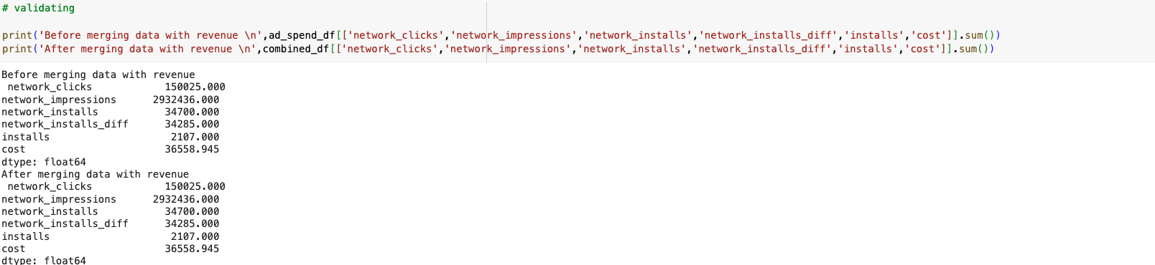
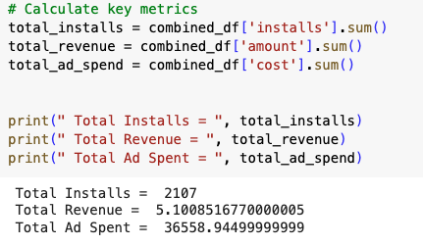
Aggregating and Merging Data:
Ad Spent Aggregation:
Aggregated the Ad Spent data by channel, Country_code and os_name to ensure we can merge the ad spent with the revenue_installs
Data Merging:
Performed a "left" join to merge the Ad Spent data with the aggregated revenue_installs data using the Country_code and os_name This ensures that all channel, country and os_name where we spent the cost for the ad are included, even if they do not have corresponding revenue_installs data.
Post merging, validated the data whether the all the total_sum is same before and after merging. If you see revenue is 5.10 which means some of the data in Ad spent does not contain data similar to revenue installs

Slide 7

Calculation Of Key Metrics
01
Total Installs
Definition: The total number of times the app has been installed.
- 2.1K
02
Total Clicks
Definition: The total number of clicks on the ads.
- 150.0K
03
Total Amount Spent on Ads
Definition: The total expenditure on advertising.
- $36.6K
04
Total Revenue
Definition: The total revenue generated.
- $5.1
Key metrics
05
Conversion Rate
Definition: The percentage of users who take a desired action after clicking the ad. - 1.92%
06
Cost per Install (CPI)
Definition: The average cost spent to acquire a single install - $587
07
Average Revenue Per User (ARPU):
Definition: The average revenue generated per user. - $0.43
08
Click-Through Rate (CTR)
Definition: The percentage of people who clicked on the ad out of the total number of people who viewed the ad - 4.91%
09
Cost per Click (CPC)
Definition: The average cost to acquire a single click - $20.84

Slide 8
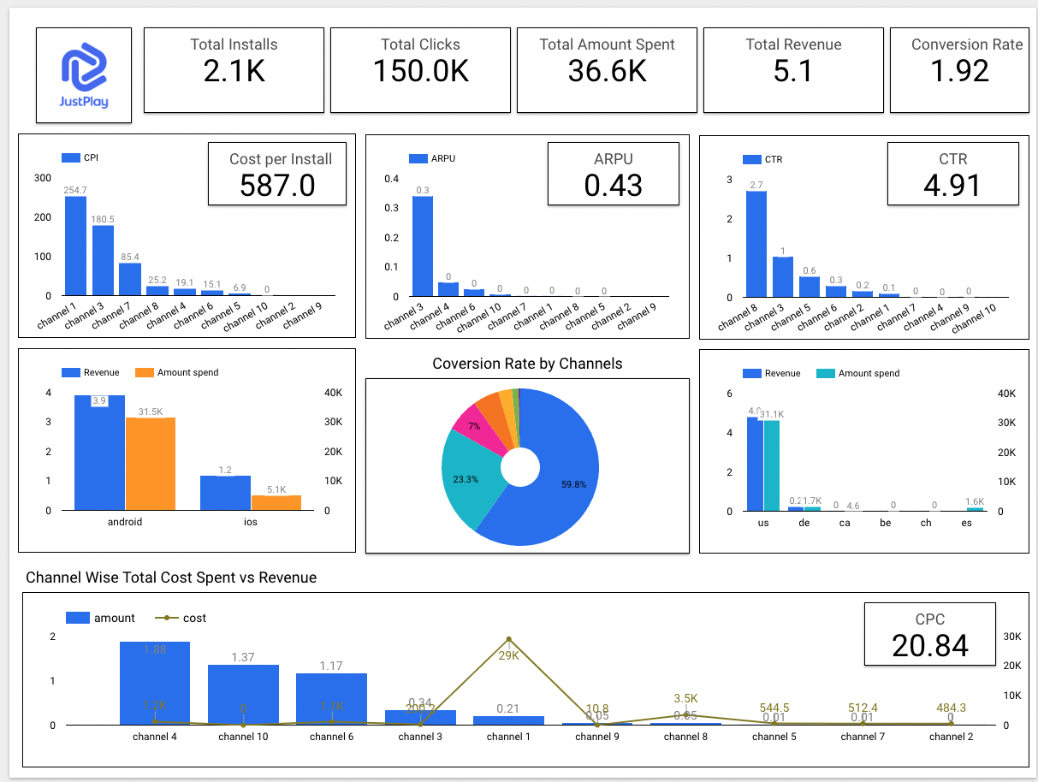
Calculation Of Key Metrics
Created a Dashboard in looker Studio Link – Looker Dashboard

Slide 9
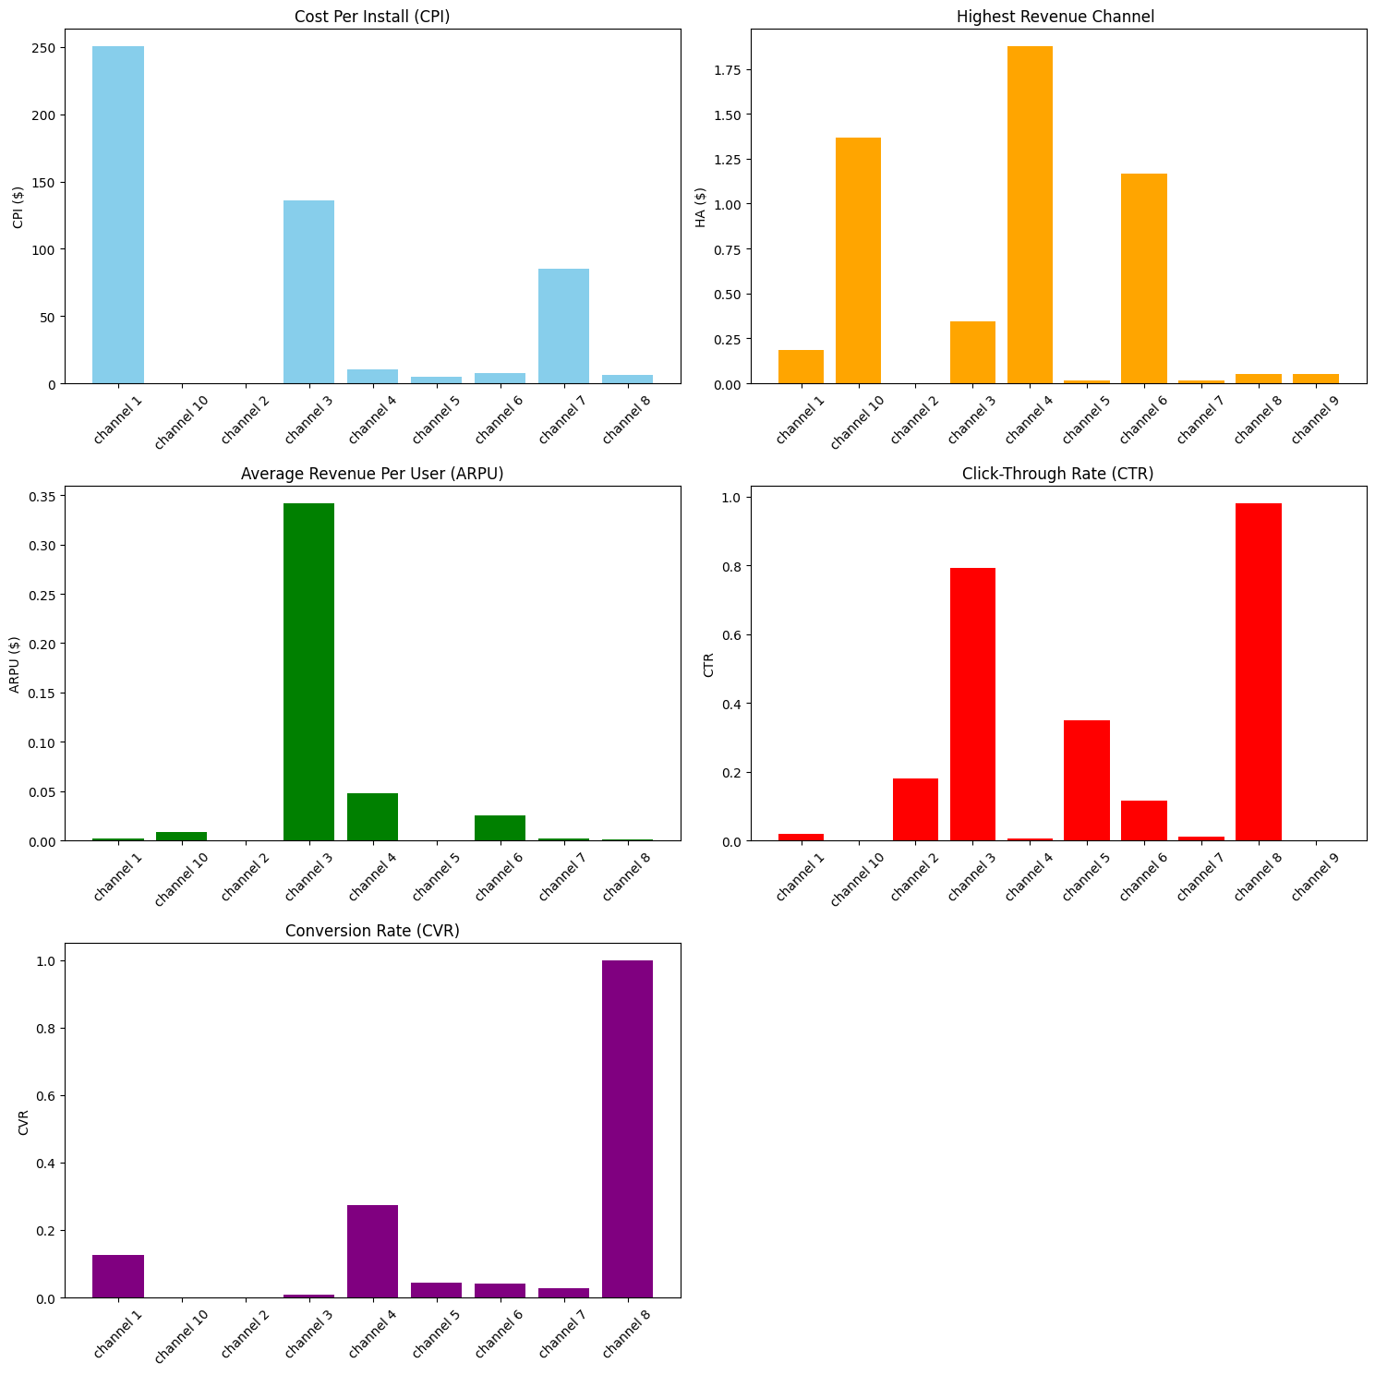
Insights and Recommendation:
Cost Per Install (CPI)
Channel 1 has the highest CPI, indicating it is the most expensive in terms of cost per install.
Channel 3 also shows a significant CPI, while other channels have a much lower CPI.
Recommendation:
Evaluate the marketing strategies for Channel 1 and Channel 3 to understand why the costs are higher. Consider optimizing or reallocating the budget to more cost-effective channels.
2. Highest Revenue Channel
Channel 4 generates the highest revenue, followed by Channel 10 and Channel 6.
Channel 1, despite having the most installs, does not generate as much revenue compared to others.
Recommendation:
Investigate why Channel 1 has high installs but lower revenue and consider strategies to convert those installs into higher revenue.
3. Average Revenue Per User (ARPU)
Channel 3 shows the highest ARPU, indicating that users acquired through this channel are more valuable in terms of revenue.Other channels have relatively low ARPU.
Recommendation:
Increase investment in Channel 3 since it delivers high-value users.
4. Click-Through Rate (CTR)
Channel 3 and Channel 8 have the highest CTR, indicating that ads on these channels are more engaging and result in more clicks. Channel 10, Channel 9 , and others have lower CTR.
Recommendation:
Analyze the ad creatives and placement strategies in Channel 3 and Channel 8 to understand what drives higher engagement and replicate these strategies in other channels.
5. Conversion Rate (CVR)
Channel 8 has the highest conversion rate, indicating that users who click on ads from this channel are more likely to install the app.
Channel 4 and Channel 1 also show decent conversion rates.
Recommendation:
Focus on increasing traffic through Channel 8 as it has the highest likelihood of converting clicks into installs.
Analyze the conversion funnels for channels with lower CVR and identify potential barriers to conversion. Improve landing page experience, streamline the install process, or provide additional incentives.

Slide 10
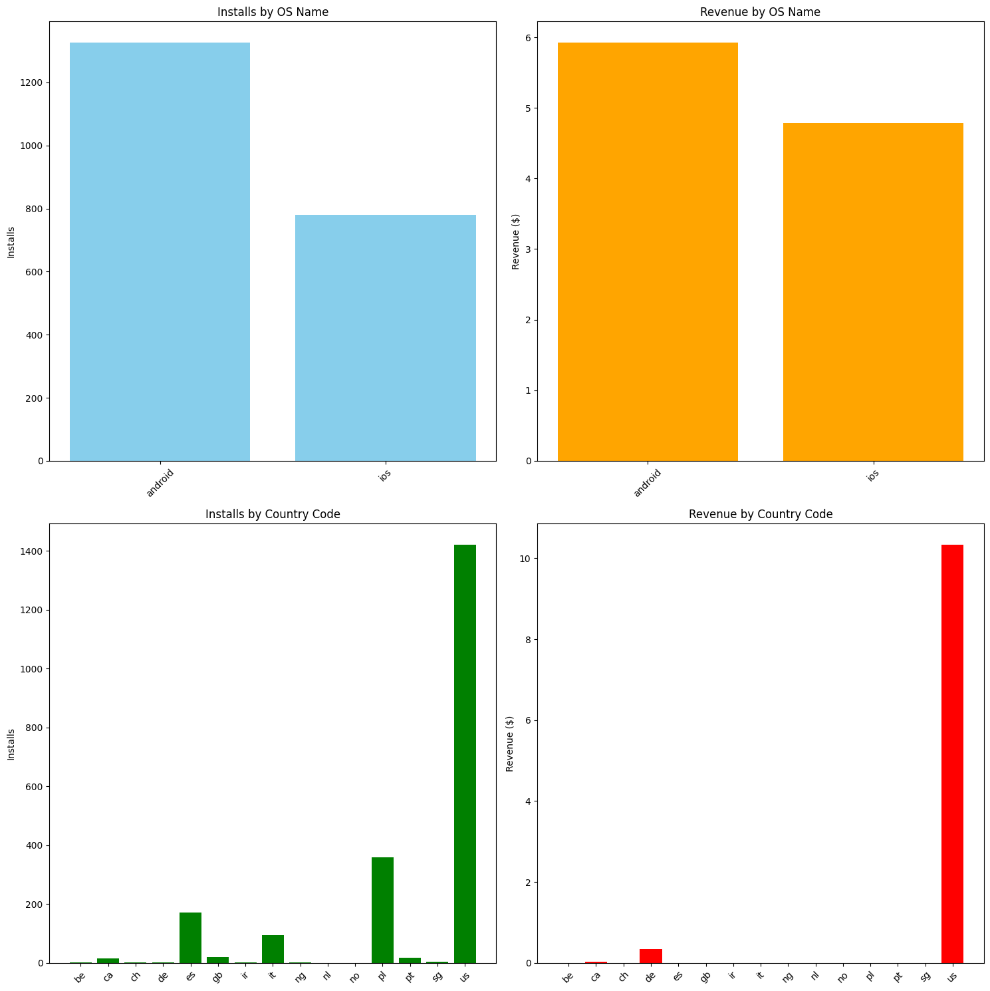
Insights and Recommendation:
1. Installs by OS Name
Android has significantly more installs compared to iOS. This indicates a higher user acquisition rate on Android devices.
Recommendation:
Continue focusing marketing efforts on Android as it appears to be the more popular platform for installs.
Investigate the reasons behind the lower number of installs on iOS. This could be due to differences in user behavior, marketing effectiveness, or app store optimization.
2. Revenue by OS Name
Android also generates more revenue than iOS, but the difference is not as large as the difference in installs.
The revenue gap between Android and iOS is smaller than the install gap, indicating that iOS users may be more valuable on a per-install basis.
Recommendation:
Consider offering exclusive features or promotions for iOS users to increase their revenue contribution.
Balance ad spend between Android and iOS to optimize overall ROI.
3. Installs by Country Code
US has the highest number of installs by a significant margin.
Other countries like pt (Portugal), br (Brazil), and in (India) also have notable numbers of installs, but much lower compared to the US.
Recommendation:
Focus marketing efforts on the US market as it is the largest source of installs.
Investigate and target secondary markets like Portugal, Brazil, and India with tailored marketing campaigns to boost installs in those regions.
4. Revenue by Country Code
US generates significantly more revenue than any other country.
Revenue from other countries is minimal in comparison to the US.
Recommendation:
Concentrate on maximizing revenue from the US market as it is the primary source of revenue.
Develop and test monetization strategies specific to the US user base to further enhance revenue.
For other countries, focus on increasing the number of installs and user engagement to eventually boost revenue. Localization and cultural adaptation of the app might help in achieving this.

Slide 11
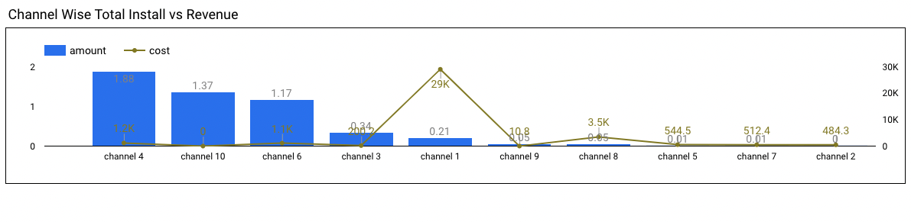
Insights and Recommendation:
Insights:
Revenue Performance:
Channels 4 and 10 are highly efficient, generating significant revenue with low costs.
Channel 1 and Channel 3 are inefficient, with high costs and low revenue
Channels 9, 8, 5, 7, and 2: These channels generate very little revenue, with Channel 2 generating the least.
Cost Distribution:
Spent a lot on channel 1. However, the revenue is very less when compared to other channel. However, didn’t spend on channel 10 it gave us good revenue Recommendations:
To optimize, increase investment in effective channels like 4 and 10, reduce spending on inefficient channels, and improve monetization strategies for moderately performing channels. Implement regular performance monitoring and campaign optimizations to ensure efficient ad spend.

Slide 12




Teams Benefited from these findings:
Marketing
Teams Benefitted
Product
Benefit:
Gain insights into user acquisition costs
Revenue generation to enhance user experience and retention strategies.
Why: Knowledge of which campaigns bring in valuable users can inform product improvements and targeted features.
Benefit:
Identify and rectify inefficient ad spends
Optimize campaign performance
Allocate budgets more effectively.
Why: Insights into high CPI and low ROAS will help in making data-driven decisions for future campaigns.
your desired text here.
Finance
Benefit:
Understand the financial impact of marketing activities
Manage budgets effectively.
Why: The detailed cost and revenue metrics are crucial for budget planning and financial forecasting.

Slide 13




Conclusion
Performance Metric
P
The average daily revenue is relatively low, indicating potential areas for revenue optimization.
There is a significant variance in ad spend across different channels, with some channels showing high spend but low returns.
Install numbers also vary greatly, pointing towards inconsistent campaign effectiveness.
R
Recommendations
Optimize Ad Spend
Enhance Campaign Strategies
Continuous Monitoring and Adjustment
Key Insights
Channel Performance: Channel 4 and Channel 10 emerged as the top performers in terms of revenue generation. These channels should be prioritized for future investments.
Ad Spend Efficiency: Channel 1 has the highest ad spend but does not deliver proportional revenue. This indicates inefficiencies that need addressing.
Cost-Effective Growth: Channels like Channel 10 demonstrate high revenue with minimal ad spend, suggesting effective organic
K
Final Thoughts
By focusing on optimizing ad spend, enhancing campaign strategies, and continuously monitoring performance, Just Play can achieve more efficient marketing operations and drive higher revenue growth. This data-driven approach will enable better allocation of resources and more informed decision-making, ultimately leading to improved business outcomes.
F

